Slide 1
Introduction to NLP
Natural language processing
Thanks to Dr. Ashraf Uddin Sir

Slide 2
Content
What is NLP?
Why is NLP?
Tasks in NLP
Challenges in NLP
Terminologies

Slide 3
What is NLP?
Natural Language Processing (NLP) is a field of artificial intelligence that focuses on the interaction between computers and humans through natural language.
Its primary goal is to enable machines to understand, interpret, and respond to human language in a way that is both meaningful and useful.

Slide 4
Why Natural Language Processing?
Bridging Human-Computer Communication
Automation of Repetitive Language Tasks
Efficient Information Extraction
Enhances Data Accessibility and Usability
Improves User Experience
Applications in Various Industries
Multilingual Capabilities

Slide 5
Why Natural Language Processing?
Amount of online textual data…
70 billion web-pages online (1.9 billion websites)
55 million Wikipedia articles
Growing at a fast pace
9000 tweets/second
3 million mail / second (60% spam)

Slide 6
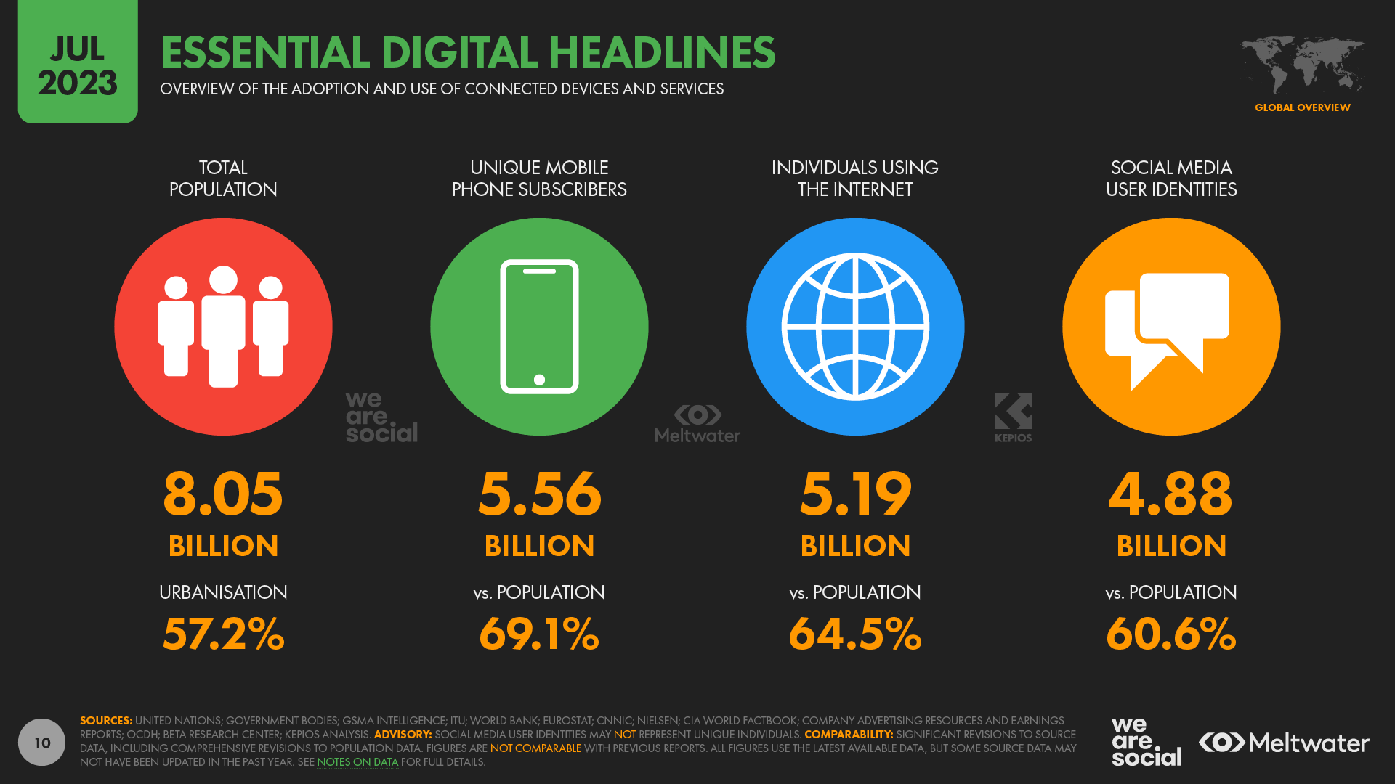
Why Natural Language Processing?

Slide 7
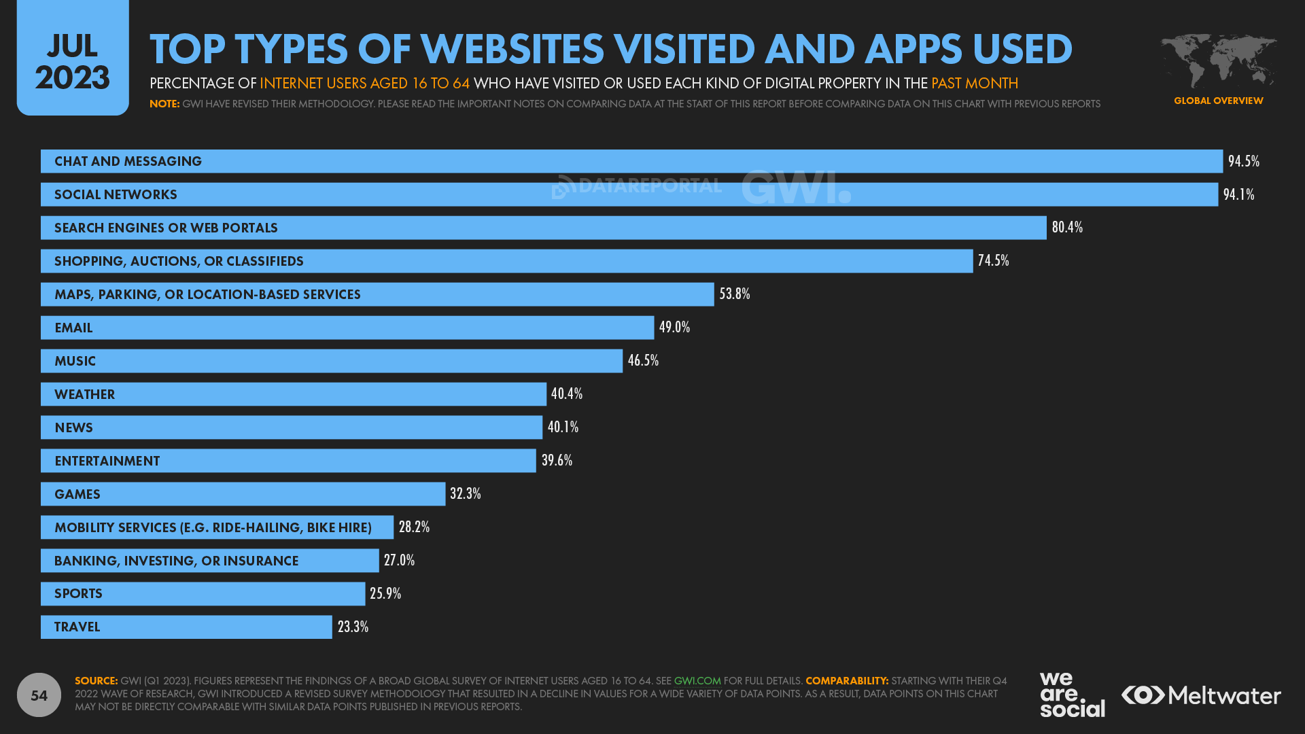
Why Natural Language Processing?

Slide 8

NLP Tasks: Document Ranking

Slide 9
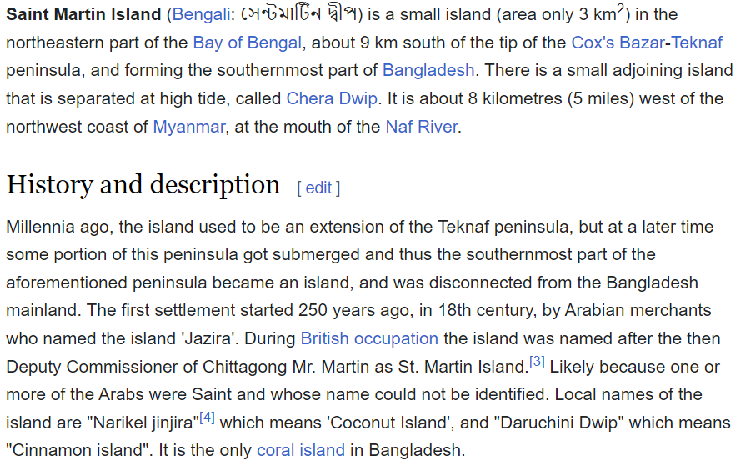
NLP Tasks: Document Classification
Sports
Travel
Politics
Economy

Slide 10
NLP Tasks: Named Entity Recognition
Identifying and classifying entities in a text into predefined categories such as names of persons, organizations, locations, dates, etc.
Example: Extracting "Google" as an organization and "California" as a location from the sentence: "Google is headquartered in California."

Slide 11
NLP Tasks: Part-of-Speech Tagging
Assigning grammatical categories (noun, verb, adjective, etc.) to each word in a sentence.
Example: In the sentence "The cat is sleeping," "The" is tagged as a determiner, "cat" as a noun, "is" as a verb, and "sleeping" as a verb.

Slide 12
NLP Tasks: Machine Translation
Automatically translating text from one language to another.
Example: Google Translate, which translates text between languages like English and Spanish.

Slide 13
NLP Tasks: Text Summarization
Generating a concise summary of a longer text while preserving its meaning.
Types:
Extractive Summarization: Extracts key sentences or phrases from the original text.
Abstractive Summarization: Generates new sentences that convey the core idea of the text.
Example: Summarizing a news article into a few key sentences.

Slide 14
NLP Tasks: Language Modeling
Predicting the next word in a sequence of words, given the previous words.
Example: Text autocompletion, such as predictive text on smartphones or autocomplete features in search engines.

Slide 15
NLP Tasks: Speech Recognition
Converting spoken language into text.
Example: Virtual assistants like Siri or Google Assistant transcribing spoken commands into text.

Slide 16
NLP Tasks: Text Generation
Generating human-like text based on a given prompt or context.
Example: GPT (Generative Pre-trained Transformer) models generating paragraphs of text based on an initial sentence or topic.

Slide 17
NLP Tasks: Question Answering (QA)
Answering questions posed in natural language, often based on a given context or knowledge base.
Types:
Open-domain QA: Can answer questions from any domain (e.g., Google search engine).
Closed-domain QA: Answers questions on a specific topic (e.g., a FAQ bot).

Slide 18
NLP Tasks: Coreference Resolution
Identifying when different words in a text refer to the same entity.
Example: In the sentence "Alice went to the store. She bought some apples," identifying that "She" refers to "Alice."

Slide 19
NLP Tasks: Sentiment Analysis
Analyzing the sentiment expressed in text, whether positive, negative, or neutral.
Example: Determining that the sentence "I love this movie!" expresses positive sentiment, while "I hated the book" expresses negative sentiment.

Slide 20
NLP Tasks: Topic Modeling
Automatically identifying topics or themes present in a collection of documents.
Example: Grouping news articles into topics like politics, sports, technology, and health

Slide 21
NLP Tasks: Dependency Parsing
Analyzing the grammatical structure of a sentence and identifying dependencies between words.
Example: Parsing the sentence "The dog chased the ball" to identify that "dog" is the subject and "ball" is the object of the verb "chased."

Slide 22
NLP Tasks: Word Sense Disambiguation
Determining the correct meaning of a word in a given context when a word has multiple meanings.
Example: In the sentence "I went to the bank to fish," identifying that "bank" refers to the side of a river, not a financial institution.

Slide 23
NLP Tasks: Dialogue Systems / Chatbots
Building systems that can engage in conversations with users, understand input, and generate appropriate responses.
Example: Virtual assistants like Alexa or customer service bots that help with queries.

Slide 24
NLP Tasks: Natural Language Inference
Determining whether a given hypothesis can be inferred from a premise, typically producing results like "entailment," "contradiction," or "neutral.“
Example: Given the premise "All dogs bark," the hypothesis "My dog barks" is an entailment, while "My dog is silent" is a contradiction.

Slide 25
NLP Tasks: Paraphrase Detection
Identifying whether two sentences have the same meaning or convey similar information.
Example: Checking if "The book was interesting" and "I found the book fascinating" are paraphrases.

Slide 26
NLP Tasks: Paraphrase Detection
Identifying whether two sentences have the same meaning or convey similar information.
Example: Checking if "The book was interesting" and "I found the book fascinating" are paraphrases.

Slide 27
Challenges
1. Productivity
2. Ambiguous
3. Variability
4. Diversity
5. Sparsity

Slide 28
Why is Language Hard to Model?
Productivity
New words, senses, structure are introduced in languages all the time
Examples: staycation and social distance were added to the Oxford Dictionary in 2021

Slide 29
Why is Language Hard to Model?
2. Ambiguous
Most linguistic observations (speech, text) are open to several interpretations
We (Humans) disambiguate - i.e. find the correct interpretation - using
all kind of signals (linguistic and extra linguistic)

Slide 30
Why is Language Hard to Model?
3. Variation
Phonetic (accent)
Morphological, Lexical (spelling)
Syntactic
Semantic

Slide 31
Why is Language Hard to Model?
Essentially, the Variability of a language depends on:
● Social Context
● Geography
● Sociology
● Date
● Topic
3. Variation
Phonetic (accent)
Morphological, Lexical (spelling)
Syntactic
Semantic

Slide 32
Why is Language Hard to Model?
4. Diversity
About 7000 languages spoken in the world
About 60% are found in the written form

Slide 33
Why is Language Hard to Model?
5. Sparsity
A large number of units are observed in language with very low frequency Very challenging for NLP

Slide 34
Why is Language Hard to Model?
In a large enough corpus, word distributions follows a Zipf Law
Word distribution in a corpus

Slide 35
Terminologies
A token is a sequence of characters (sometimes a word, sometimes several words, sometimes a sub-word…)
A document can be: A Sentence. A Paragraph. A sequence of characters

Slide 36
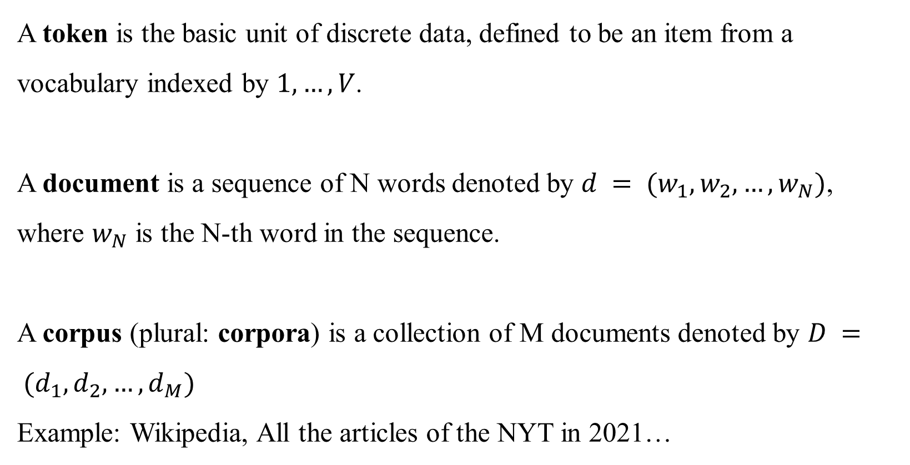
Terminologies
A token is the basic unit of discrete data, defined to be an item from a vocabulary indexed by $1, …, V$.
A document is a sequence of N words denoted by $d = (w_{1},w_{2}, …,w_{N})$, where $w_{N}$ is the N-th word in the sequence.
A corpus (plural: corpora) is a collection of M documents denoted by $D = (d_{1},d_{2},…,d_{M})$
Example: Wikipedia, All the articles of the NYT in 2021…

Slide 37
References
Daniel Jurafsky and James H. Martin. 2024. Speech and Language Processing: An Introduction to Natural Language Processing, Computational Linguistics, and Speech Recognition with Language Models, 3rd edition.
"Natural Language Processing with Python" by Steven Bird, Ewan Klein, and Edward Loper
"Deep Learning for Natural Language Processing" by Jason Brownlee

